Slide 1

MachineLearning Pilot Image Quality control
Natalia An
Senior Consultant @Inmeta

Slide 2
Agenda
Story
Scope
Implementation
Toolbox
Results

Slide 3


Story behind
Repetitive work
High cost
+

Slide 4
Automated Image Quality Control
Detect blur
Detect unclear edges
Detect gloss
Classification

Slide 5
Schedule
4 weeks for proof of concept
Foreach {Task}
Gather data
Research
Implement -> Validate

Slide 6
Process
Research
Collect training materials
Feature engineering
ML algorithm
selection & tuning
Features WebService
AzureML WS

Slide 7
Toolbox
Research and algorithm validation:
R Studio
Google ☺
Feature ingeneering (code, build, deploy):
Visual Studio 2015 (C#, MVC WebApi, Javascript)
Visual Studio Online (Git)
Azure
ML implementation, Deploy:
Azure Machine Learning

Slide 8
Case 1
Detect Blur

Slide 9
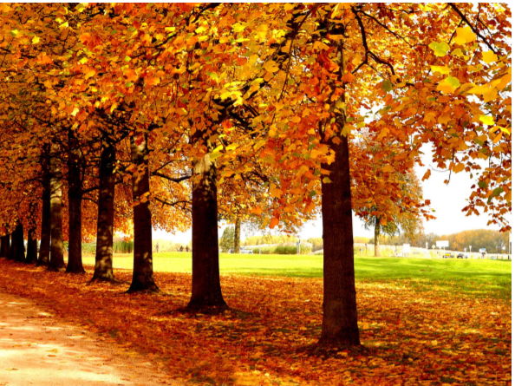
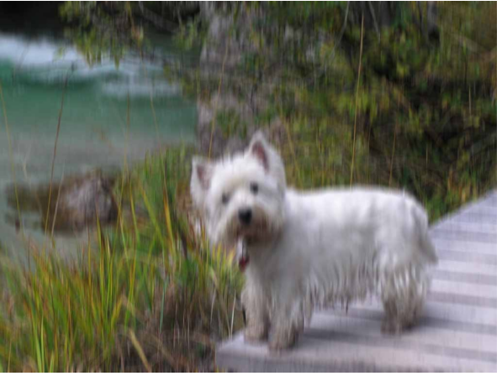


Example

Slide 10
Approach
Feature engineering:
Histograms of Oriented Gradients (gradient magnitude and gradient direction)
*http://graphics.im.ntu.edu.tw/docs/mmm08.pdf
ML algorithm:
Support Vectors Machine

Slide 11
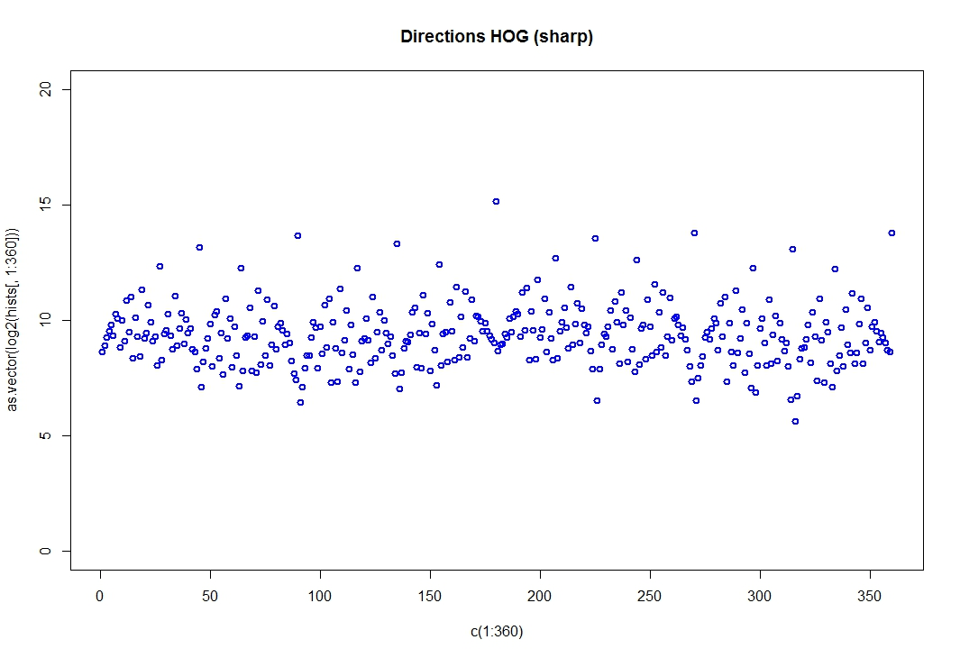
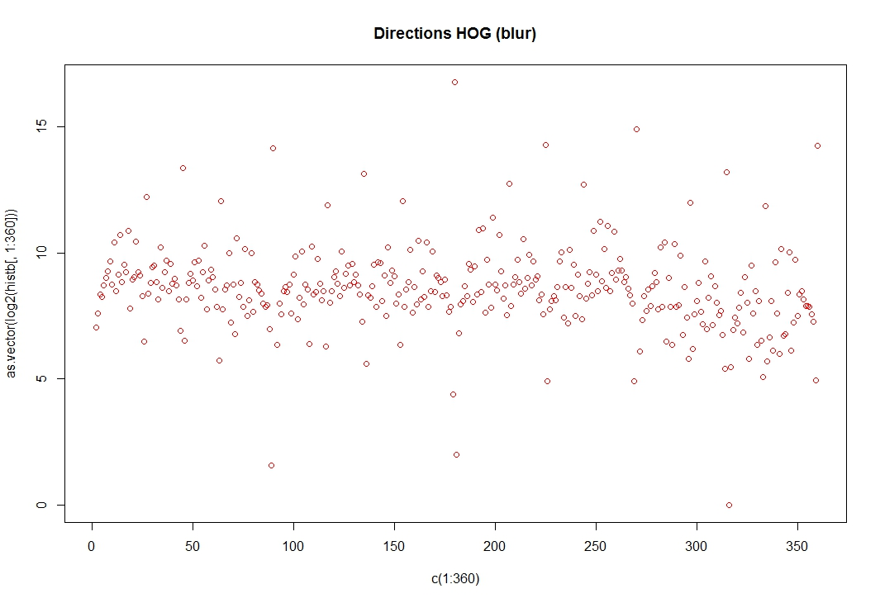
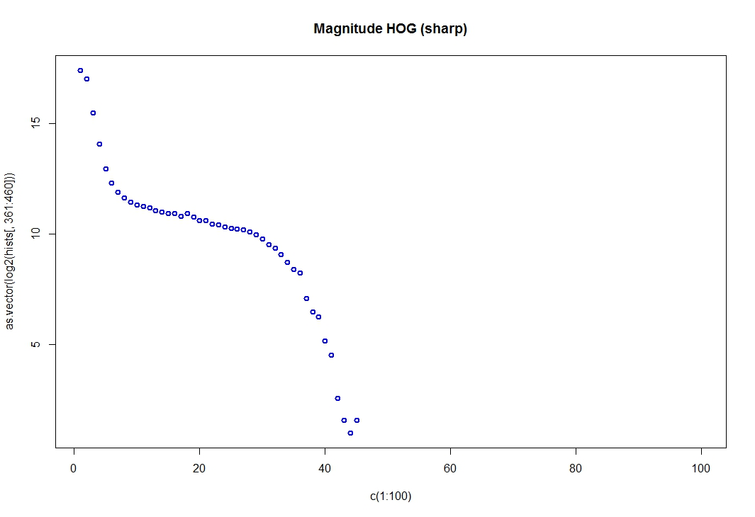
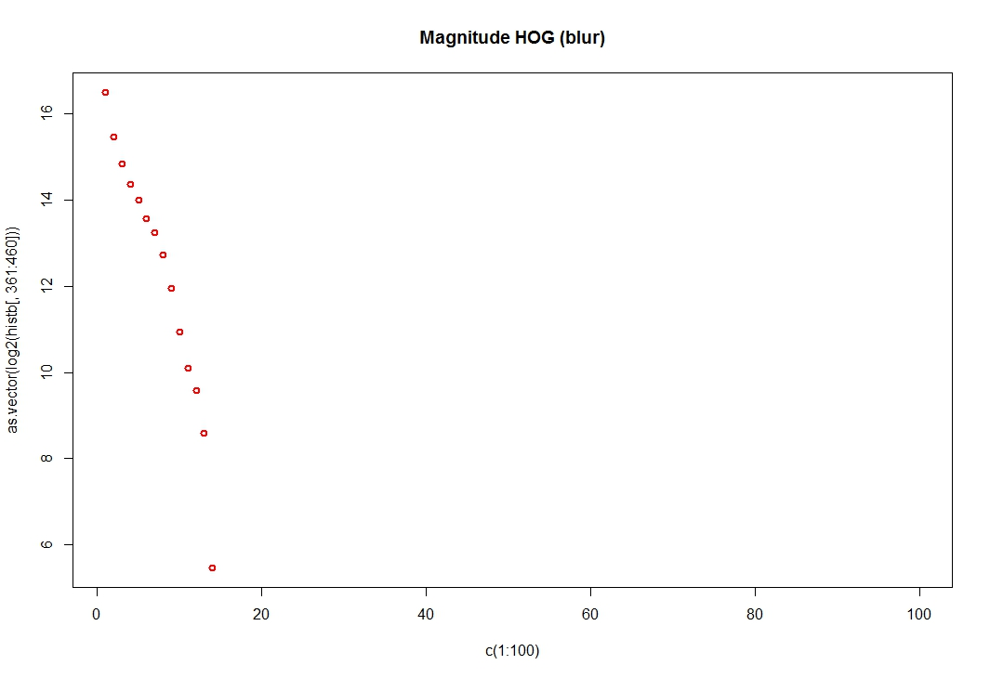
HOG comparison

Slide 12
Blur detection on whole picture
Training on:
Pictures from internet (thank you, google.com)
Results:
97% classified correct

Slide 13
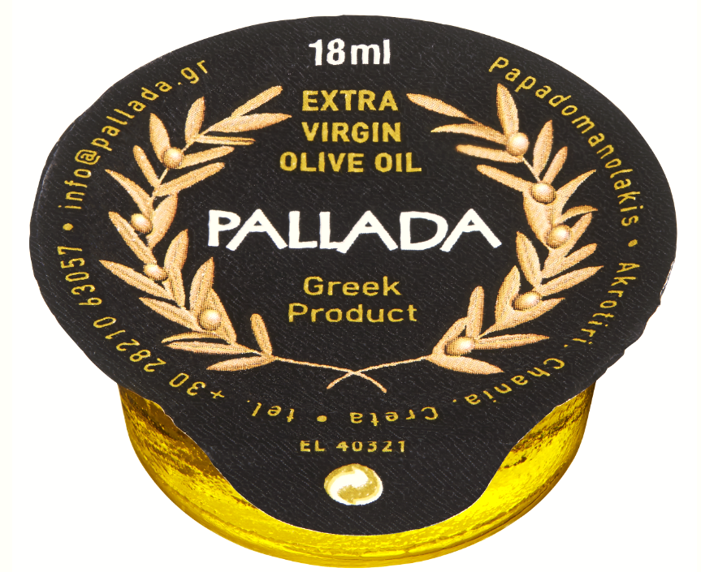
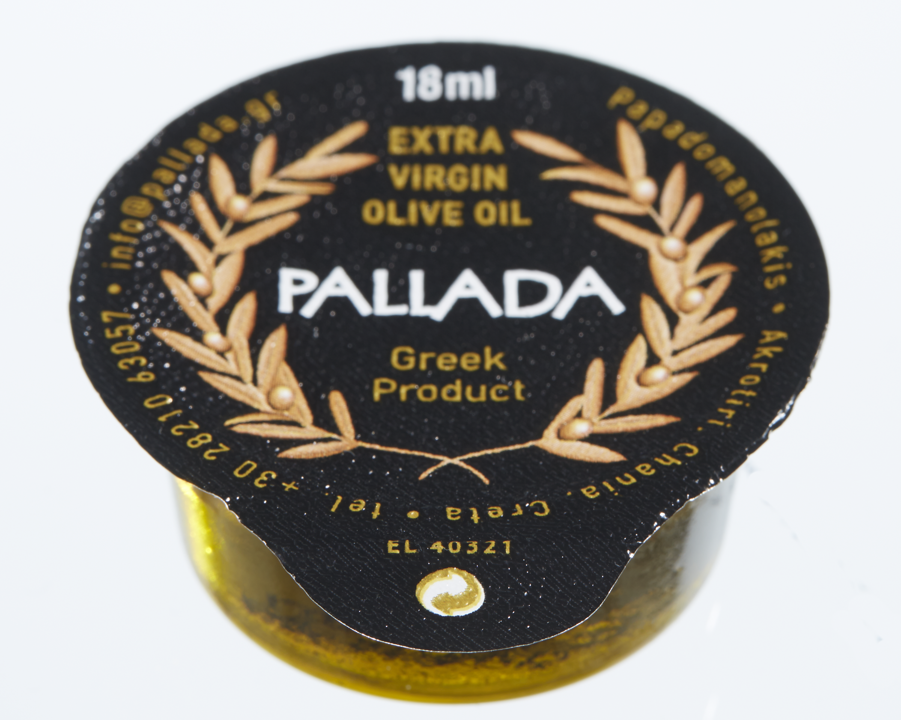
Local Blur
Detect blur (out of focus) parts in pictures

Slide 14

Local Blur: Training data?
Few blur pics (15 only)
Can not train and test on same data!

Slide 15
Local Blur: Training data!
Blur training data:
Take sharp images
Cut into parts a 500px width (height proportional)
Apply 2 types Gaussian blur to each part
Sharp training data:
Sharp images parts

Slide 16
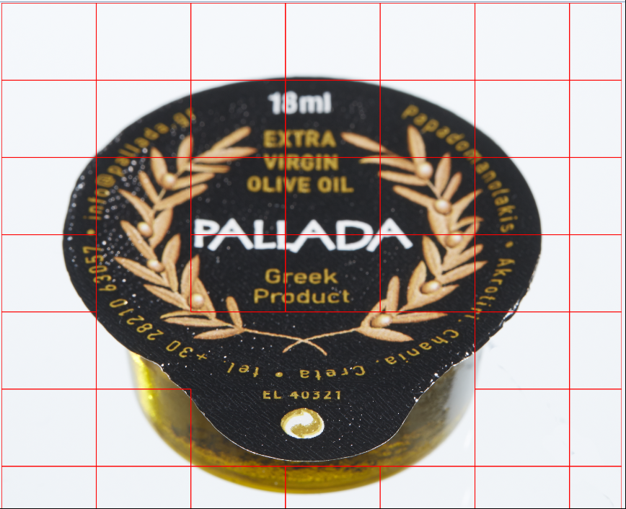
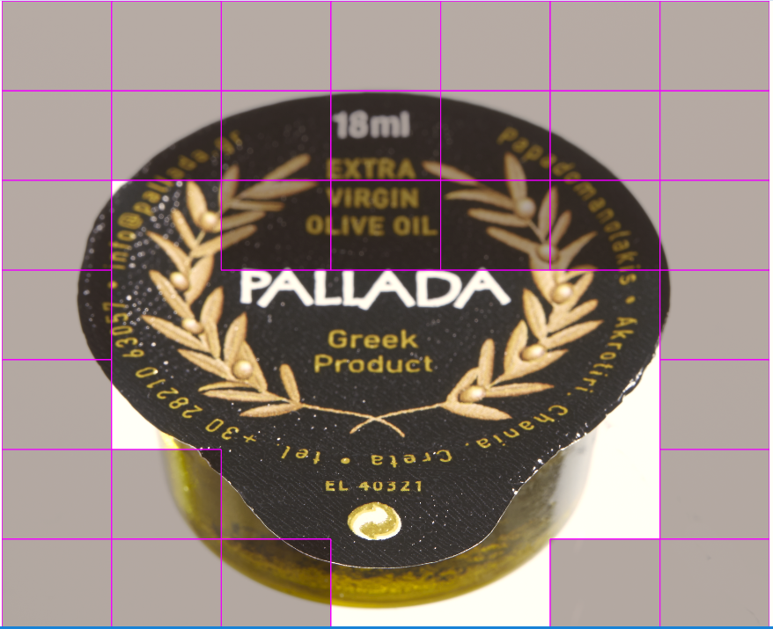
Local Blur: detection approach
For each part run Global blur detection
Count % of blur parts
Blur if % > Threshold

Slide 17
Local Blur: Results
Sharp parts
Real data
Gaussian blur A
Gaussian blur B
Detect blur on parts
Train 70%
30% Validate
Apply treshold
72% correct
(whole pic)
92% correct
(on parts)

Slide 18
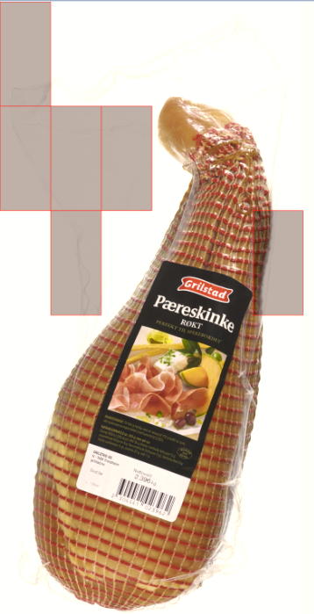
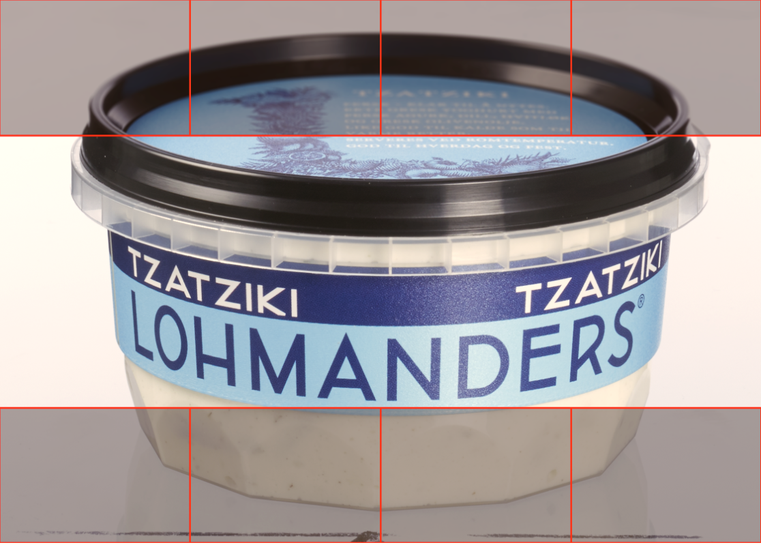
Local blur: Results
72% accuracy (at 40% treshold)

Slide 19
Deployment
Image
Blur detection
web service
(1. create features)
Azure ML
web service
(2. blur detection)

Slide 20
Case 2
Detect Unclear edges

Slide 21
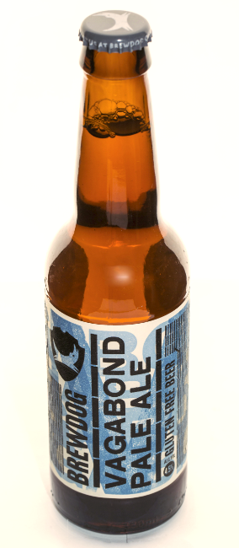
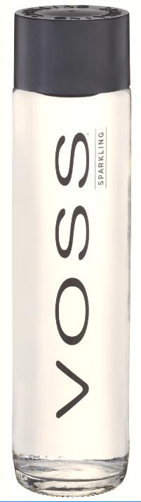
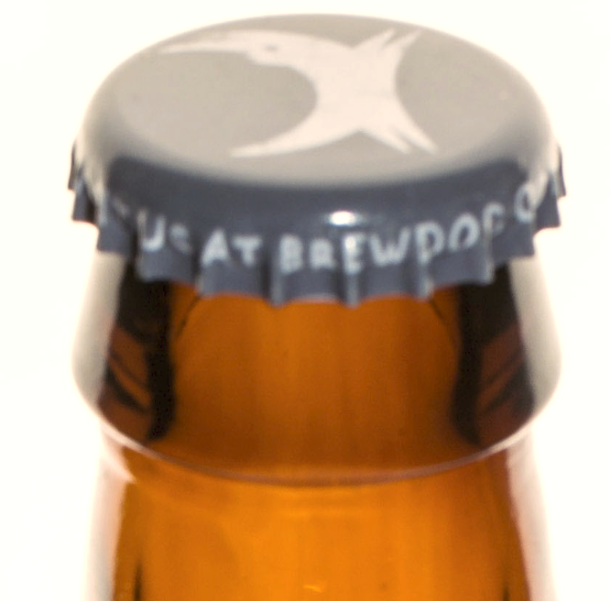
Unclear edges: Example

Slide 22
Unclear edges : detection approach
Algorithm:
Support Vector Machine
Features:
Preprosess picture to identify edges
Filter Saturation 0-0.03, Luminance 0.97-1
Convert to grayscale
Canny edge detection
Use top 10 longest edges as features for learning

Slide 23


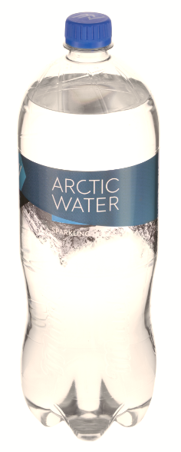
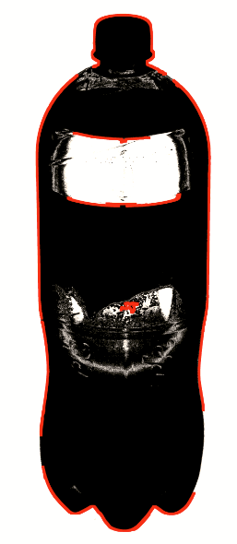
Unclear edges : feature example
231056,0,0,0,0,0,0,0,0,0
1056,897,230,104,65,12,8,0,0,0

Slide 24
Unclear edges: Data & Results
Data split:
60% - Training set
20% - Cross Validation set
20% - Test set
Results :
94% accuracy on Cross Validation set
89% accuracy on Test set

Slide 25
Case 3
Detect Gloss

Slide 26


Gloss : Example

Slide 27
Gloss : Approach
ML algorithm:
Support Vector Machine
Features:
Preprosessing of picture to highlight glossy areas
Scale down
HSL Filter
Grayscale
Gaussian blur
Otsu treshold with converting to black\white
Edge detection Canny
Use top 15 largest areas as features for training

Slide 28
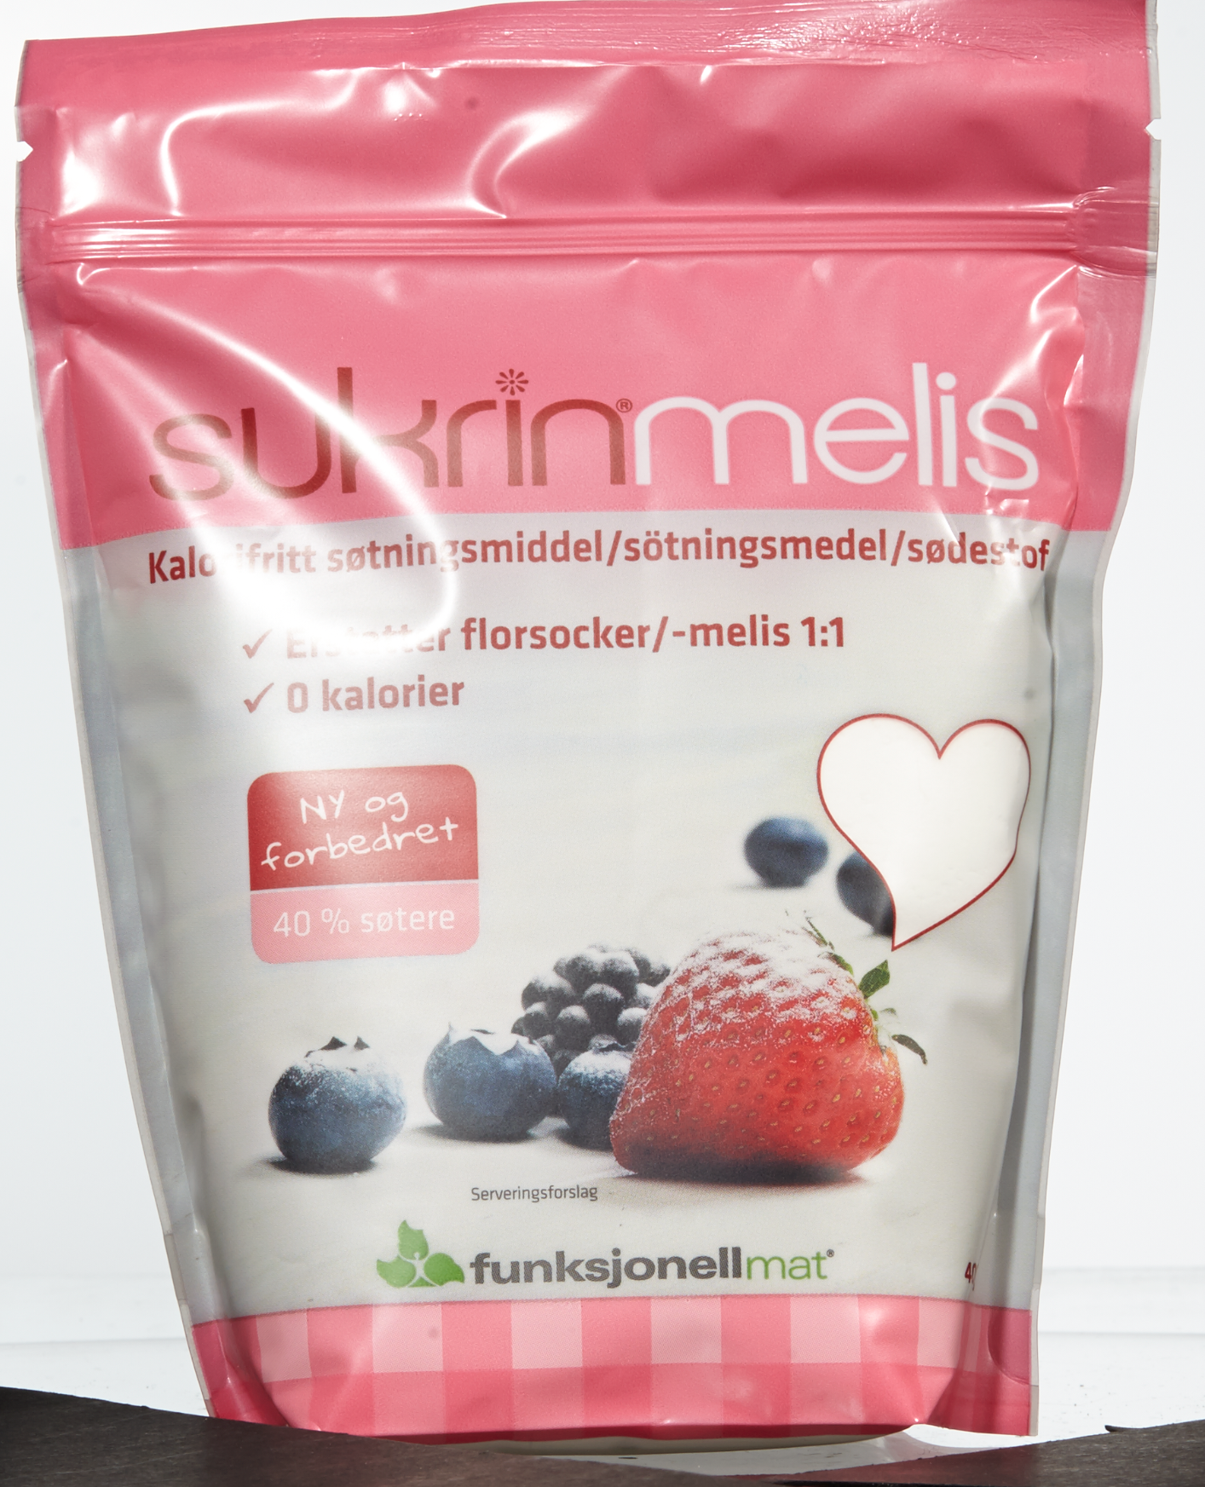


Gloss : features examples
1329,425,359,169,139,86,67,58,48,47,37,34,32,29,28
5979,0,0,0,0,0,0,0,0,0,0,0,0,0,0

Slide 29
Gloss: Training data & Results
Data split:
60% - Training set
20% - Cross Validation set
20% - Test set
Results :
94% accuracy on Cross Validation set
97% accuracy on Test set

Slide 30
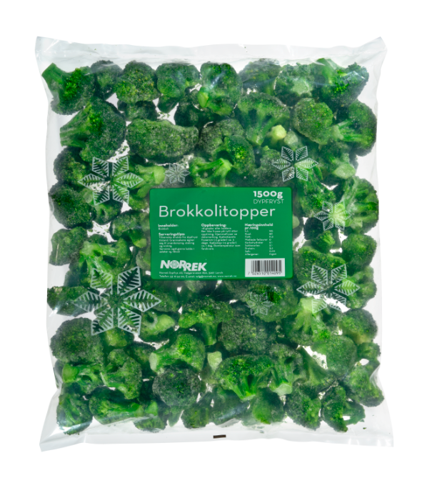




Automated Quality Control
el.
Blur?
Unclear edges?
Glossy?
<xxx>?
Manual afterkontroll

Slide 31
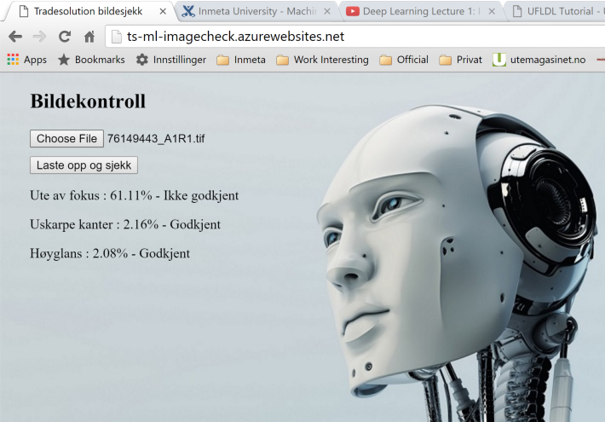
Show time!
http://ts-ml-imagecheck.azurewebsites.net/

Slide 32
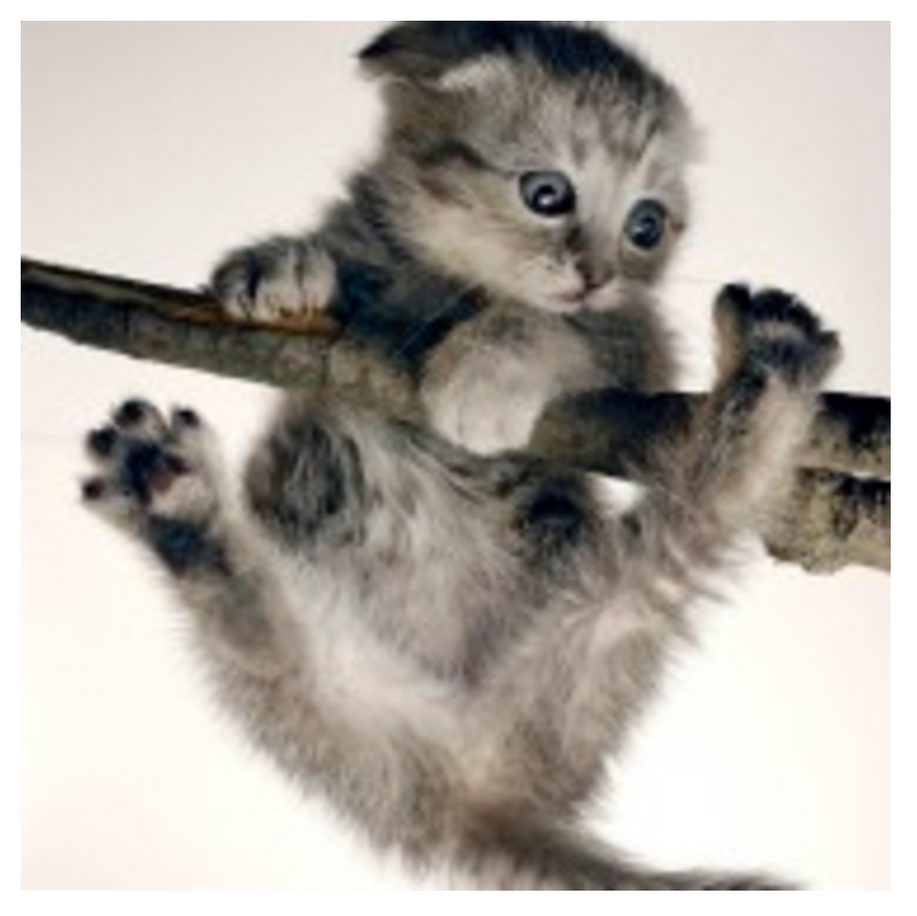
Live demo coding
Show AzureML portal with experiment
A1: Edge detection
Explain experiment
Deploy experiment as a web service
Connect client in Visual Studio
C:\TS\Meetup\ML.HoyGlansDetection.Web
Run example
Mandatory cute kitten pic →

